Slide 1

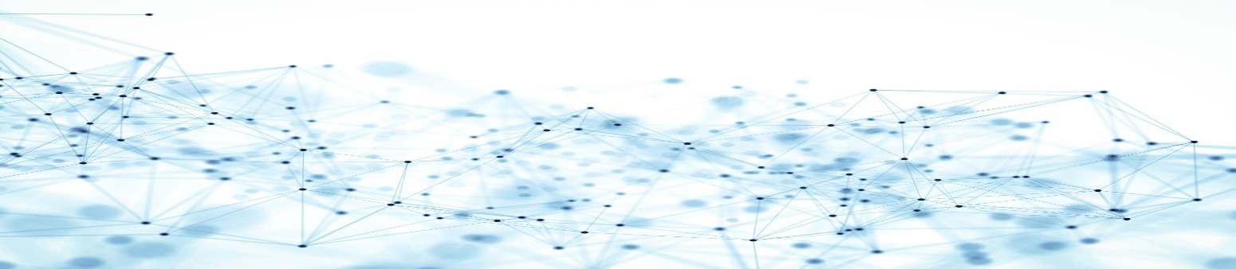
A Gentle Introduction to Graph Convolution Network (GCN)
Hugh Nguyen
Data Scientist Co-op
RBC – Joint Security Operations Center
Date: 2018/12/06

Slide 2
AGENDA
Outstanding Questions:
What is a graph? Why do we even bother using it?
What is Convolution Neural Network? Why does it fail on graph?
What is Graph Convolution Network and some of its applications?
Semi-supervised Nodes Classification Performance Review
Graph Convolution Network (GCN)
Graph Overview

Slide 3
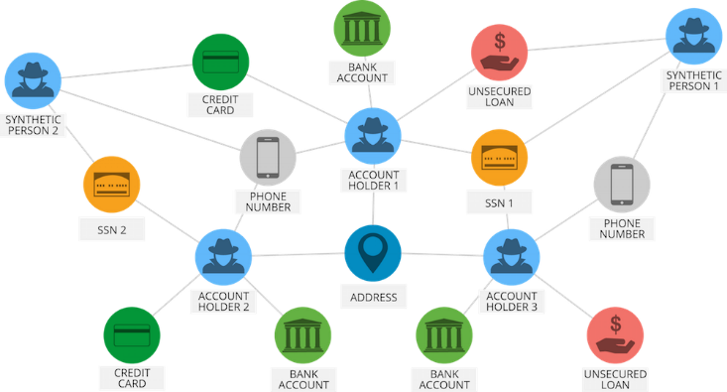
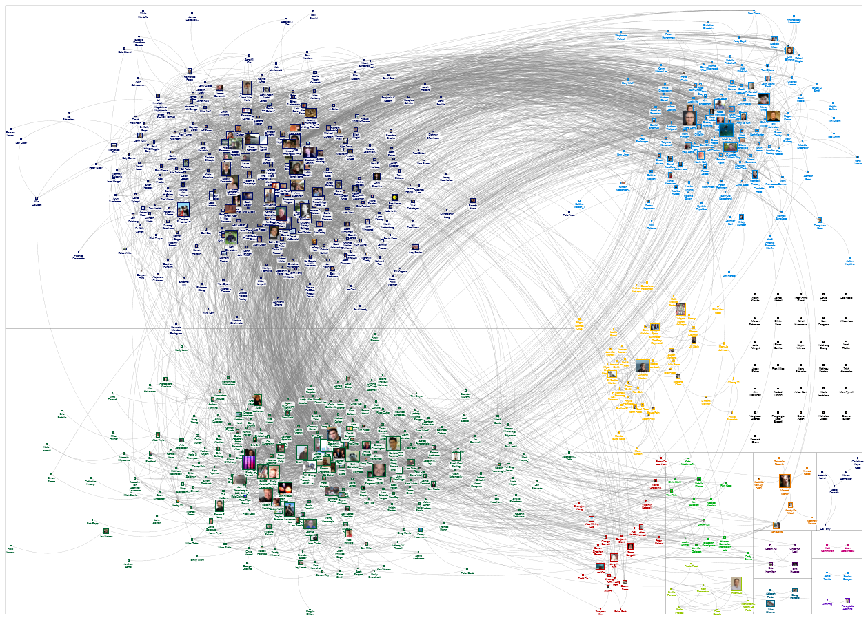
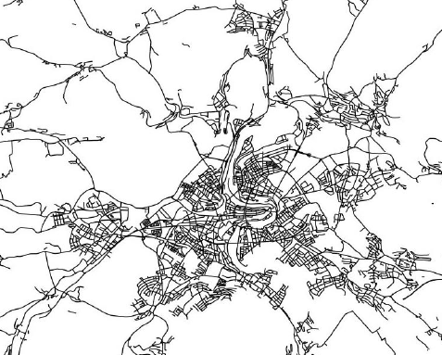
NETWORK IS EVERYWHERE
Graph Convolution Network (GCN)
Graph Overview

Slide 4

Convolutional Neural Network (CNN)

Slide 5

CONVOLUTION NEURAL NETWORK (CNN)
.92
X
Convolution
ReLU
Convolution
ReLU
Pooling
Fully
connected
Fully
connected
Convolution
ReLU
Pooling
O
.51
Graph Convolution Network (GCN)
Source: Brandon Rohrer (Facebook)
CNN Architecture
Notes:
Prob sum = 1

Slide 6
FILTERING
Consider this image: (2D Matrix)
Graph Convolution Network (GCN)
Source: Brandon Rohrer - Facebook
CNN Architecture

Slide 7
FILTERING OPERATION
Features match pieces of the image
=
+
+
Graph Convolution Network (GCN)
Source: Brandon Rohrer
CNN Architecture

Slide 8
FILTERING OPERATION
Graph Convolution Network (GCN)
Source: Brandon Rohrer
CNN Architecture

Slide 9
FILTERING OPERATION
Graph Convolution Network (GCN)
Source: Brandon Rohrer
CNN Architecture

Slide 10
FILTERING OPERATION
Graph Convolution Network (GCN)
Source: Brandon Rohrer
CNN Architecture

Slide 11
FILTERING OPERATION
1 x 1 = 1
Graph Convolution Network (GCN)
Source: Brandon Rohrer
CNN Architecture

Slide 12
FILTERING OPERATION
-1 x -1 = 1
Graph Convolution Network (GCN)
Source: Brandon Rohrer
CNN Architecture

Slide 13
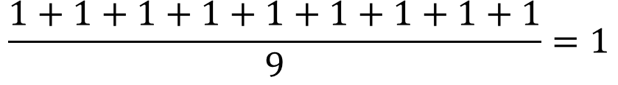
FILTERING OPERATION
$$\frac{1+1+1+1+1+1+1+1+1}{9}=1$$
Graph Convolution Network (GCN)
Source: Brandon Rohrer
CNN Architecture

Slide 14
FILTERING OPERATION
Graph Convolution Network (GCN)
Source: Brandon Rohrer
CNN Architecture

Slide 15
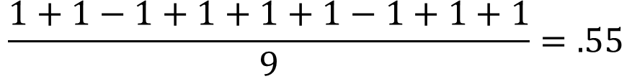
FILTERING OPERATION
$$\frac{1+1−1+1+1+1−1+1+1}{9}=.55$$
.55
Graph Convolution Network (GCN)
Source: Brandon Rohrer
CNN Architecture

Slide 16
FILTERING OPERATION
Graph Convolution Network (GCN)
Source: Brandon Rohrer
CNN Architecture

Slide 17
FILTERING OPERATION
=
Graph Convolution Network (GCN)
Source: Brandon Rohrer
CNN Architecture

Slide 18
FILTERING OPERATION
=
=
=
Graph Convolution Network (GCN)
Source: Brandon Rohrer
CNN Architecture

Slide 19
CONVOLUTION LAYER
A stack of filters forms a convolution layer
Graph Convolution Network (GCN)
Source: Brandon Rohrer
CNN Architecture

Slide 20
POOLING OPERATION
Select a pooling window size; go with 2
Select a stride; go with 2
Graph Convolution Network (GCN)
Source: Brandon Rohrer
CNN Architecture

Slide 21
POOLING OPERATION
maximum
Graph Convolution Network (GCN)
Source: Brandon Rohrer
CNN Architecture

Slide 22
POOLING OPERATION
maximum
Graph Convolution Network (GCN)
Source: Brandon Rohrer
CNN Architecture

Slide 23
POOLING OPERATION
maximum
Graph Convolution Network (GCN)
Source: Brandon Rohrer
CNN Architecture

Slide 24
POOLING OPERATION
max pooling
Graph Convolution Network (GCN)
Source: Brandon Rohrer
CNN Architecture

Slide 25
POOLING OPERATION
Graph Convolution Network (GCN)
Source: Brandon Rohrer
CNN Architecture
Notes:
To avoid over fitting + ease to work with FC at the end

Slide 26
ACTIVATION FUNCTION – ReLU
Graph Convolution Network (GCN)
Source: Brandon Rohrer
CNN Architecture

Slide 27
ACTIVATION FUNCTION – ReLU
Graph Convolution Network (GCN)
Source: Brandon Rohrer
CNN Architecture

Slide 28
ACTIVATION FUNCTION – ReLU
Graph Convolution Network (GCN)
Source: Brandon Rohrer
CNN Architecture

Slide 29
SO FAR …
Graph Convolution Network (GCN)
Source: Brandon Rohrer
CNN Architecture

Slide 30
SO FAR …
Convolution
ReLU
Convolution
ReLU
Pooling
Convolution
ReLU
Pooling
Graph Convolution Network (GCN)
Source: Brandon Rohrer
CNN Architecture

Slide 31
FULLY CONNECTED LAYER
X
O
Graph Convolution Network (GCN)
Source: Brandon Rohrer
CNN Architecture

Slide 32

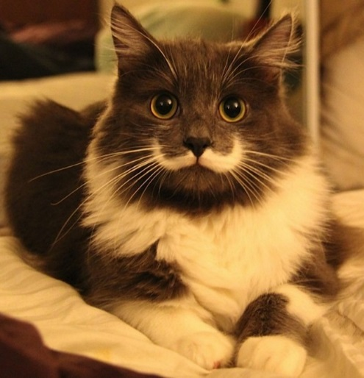
CNN FULL STACK
.95
X
Convolution
ReLU
Fully
connected
Fully
connected
Convolution
ReLU
Convolution
ReLU
Pooling
Pooling
O
.11
Graph Convolution Network (GCN)
Source: Brandon Rohrer
CNN Architecture

Slide 33
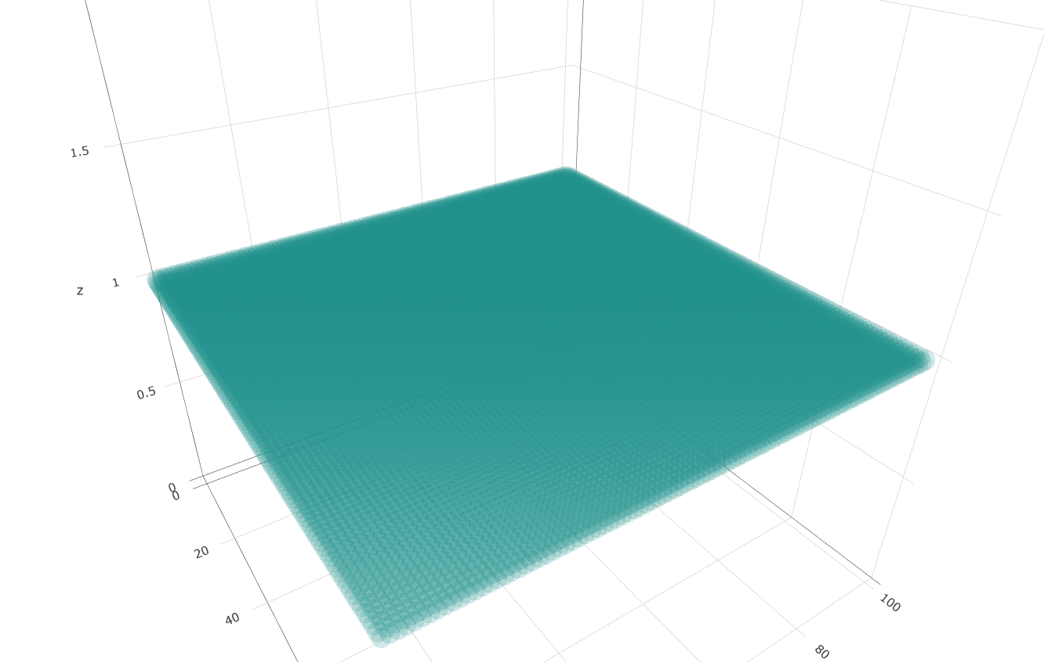
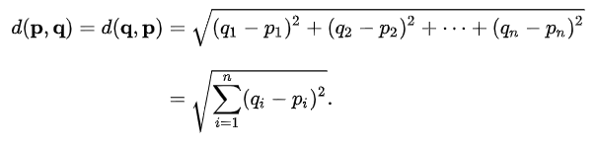
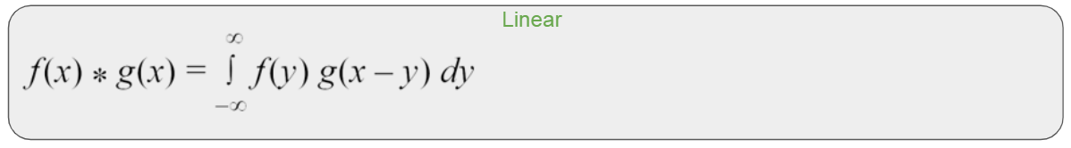
CNN PROS
Graph Convolution Network (GCN)
CNN Architecture

Slide 34
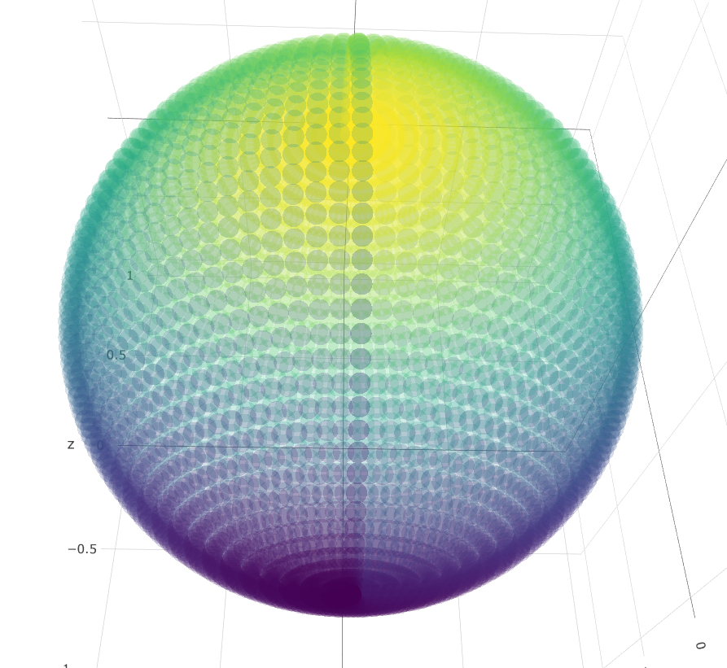
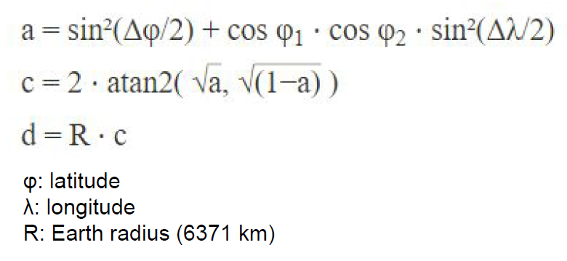
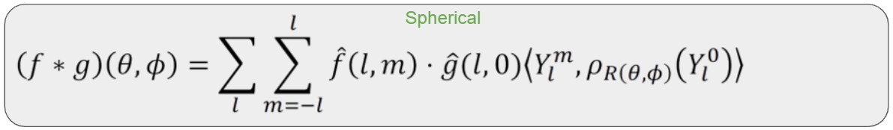
CNN PROS
Graph Convolution Network (GCN)
CNN Architecture

Slide 35
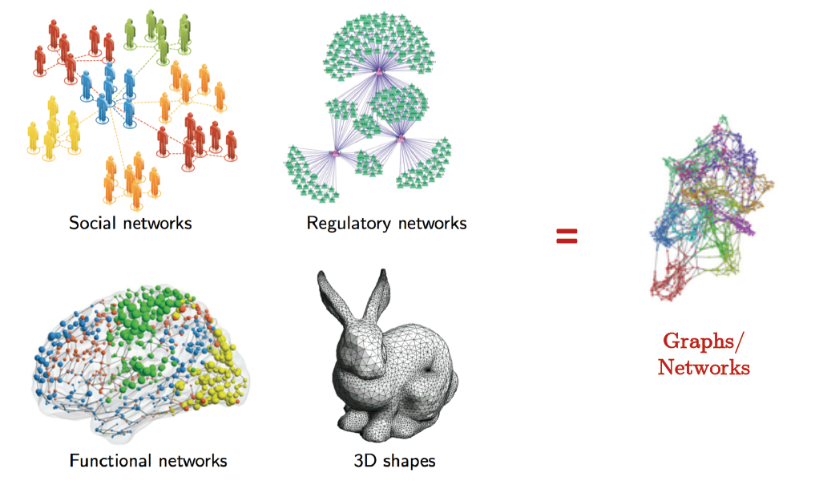
WAIT WHAT … ?
Graph Convolution Network (GCN)
CNN Architecture

Slide 36
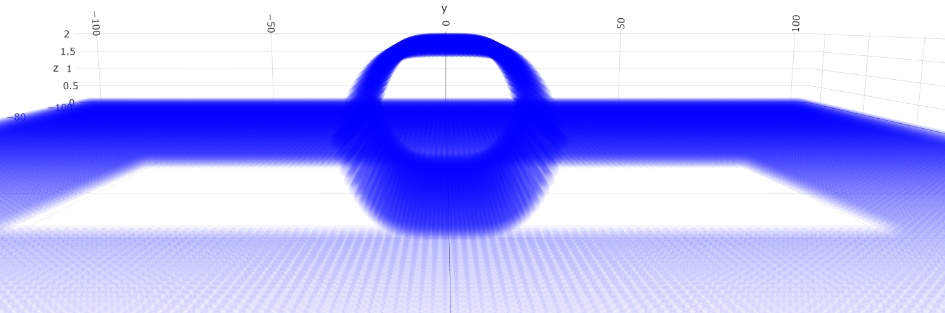
CNN CANNOT HANDLE NON-EUCLIDEAN DOMAIN
Graph Convolution Network (GCN)
CNN Architecture

Slide 37
Spectral Graph Theory 101

Slide 38
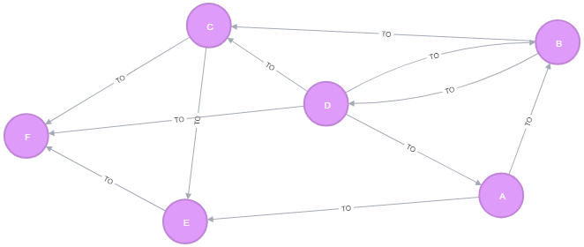
WHAT IS A GRAPH?
Graph Convolution Network (GCN)
Source: Stanford Spectral Graph Theory
Spectral Graph Theory 101

Slide 39
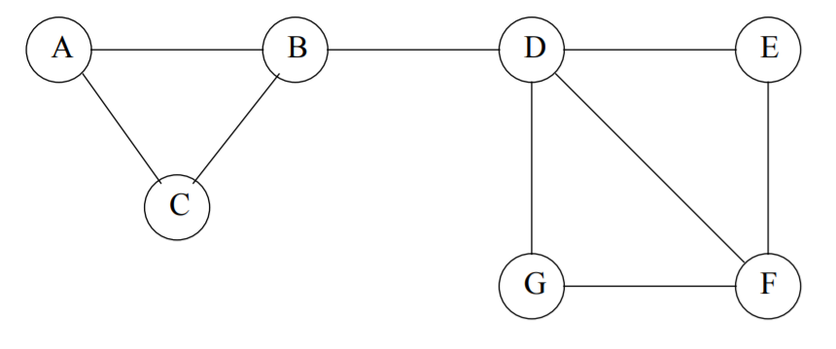
MATRIX REPRESENTATION OF A GRAPH
Graph Convolution Network (GCN)
Source: Stanford Spectral Graph Theory
Spectral Graph Theory 101
Notes:
Matrices plays a significant role in describing a graph connectivity, its centrality within a network

Slide 40
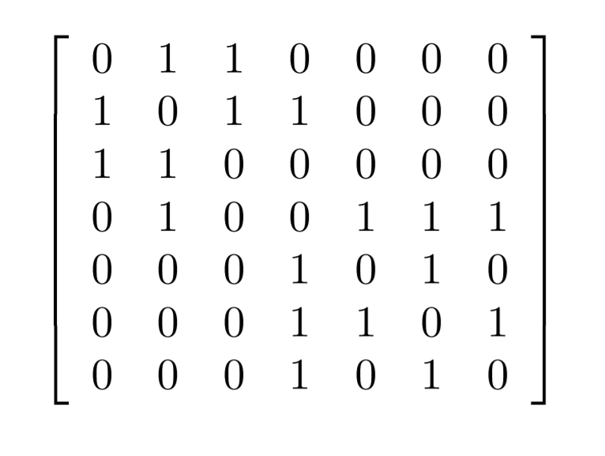
ADJACENCY MATRIX
A
B
C
D
E
F
G
A
B
C
D
E
F
G
Graph Convolution Network (GCN)
Source: Stanford Spectral Graph Theory
Spectral Graph Theory 101
Notes:
Matrices plays a significant role in describing a graph connectivity, its centrality within a network

Slide 41
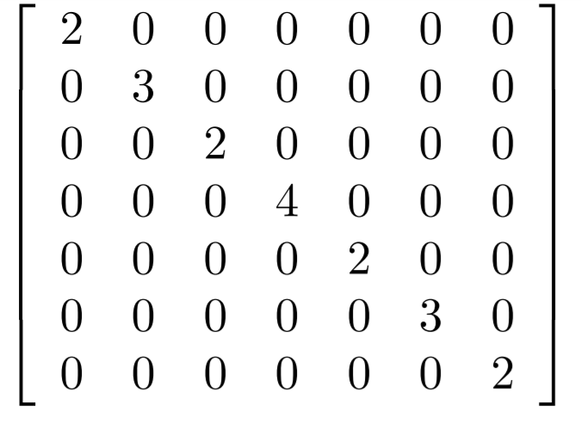
DEGREE MATRIX
A
B
C
D
E
F
G
A
B
C
D
E
F
G
Graph Convolution Network (GCN)
Source: Stanford Spectral Graph Theory
Spectral Graph Theory 101
Notes:
Matrices plays a significant role in describing a graph connectivity, its centrality within a network

Slide 42
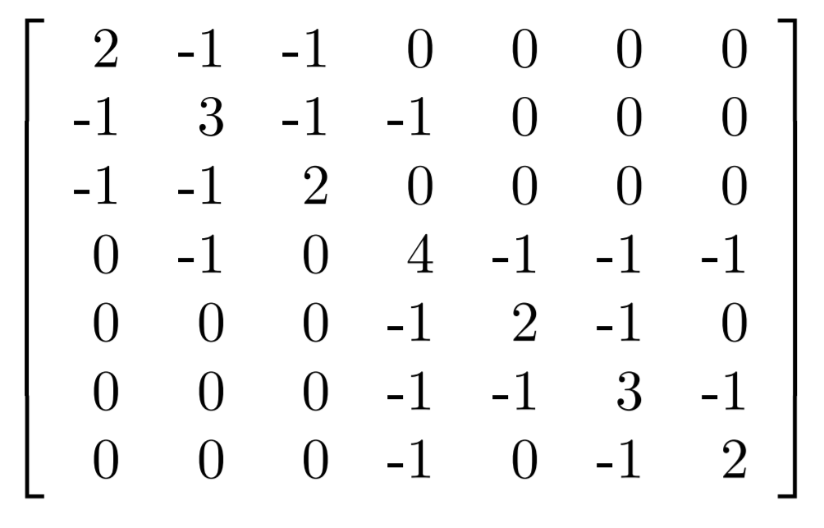
LAPLACIAN MATRIX
A
B
C
D
E
F
G
A
B
C
D
E
F
G
Graph Convolution Network (GCN)
Source: Stanford Spectral Graph Theory
Spectral Graph Theory 101
Notes:
Matrices plays a significant role in describing a graph connectivity, its centrality within a network
Add the formula

Slide 43
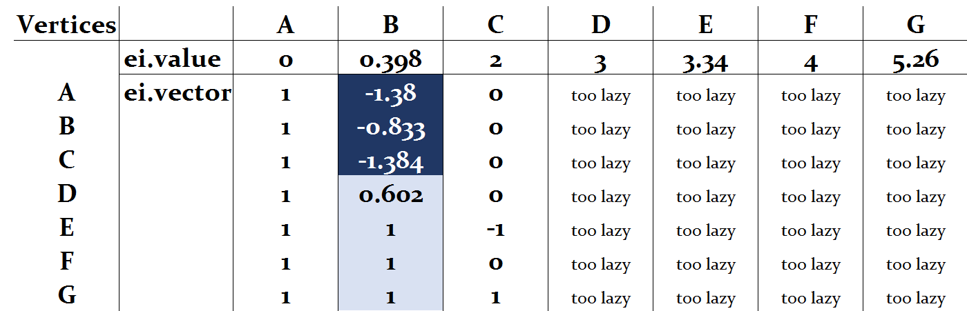
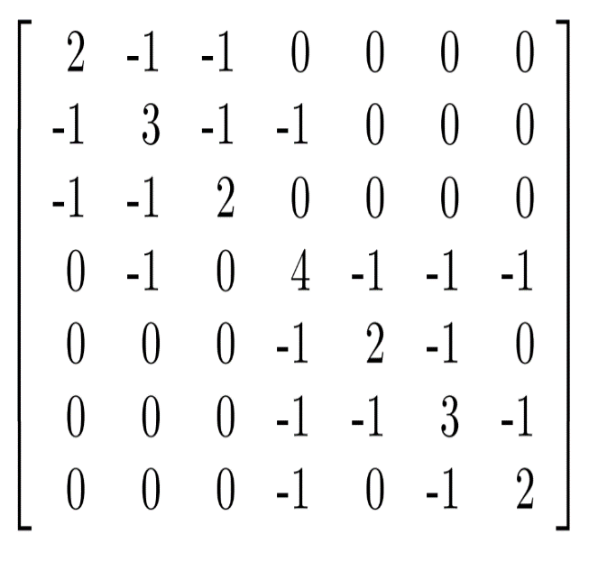
SPECTRAL GRAPH PARTIONING – FIEDLER 1973
A
B
C
D
E
F
G
A
B
C
D
E
F
G
Graph Convolution Network (GCN)
Source: Stanford Spectral Graph Theory
Spectral Graph Theory 101
Notes:
Graph theory provide graph clustering techniques to reformulate downsampling for graphs
Spectral graph theory allows to redefine convolution in the context of graphs with Fourier analysis.

Slide 44
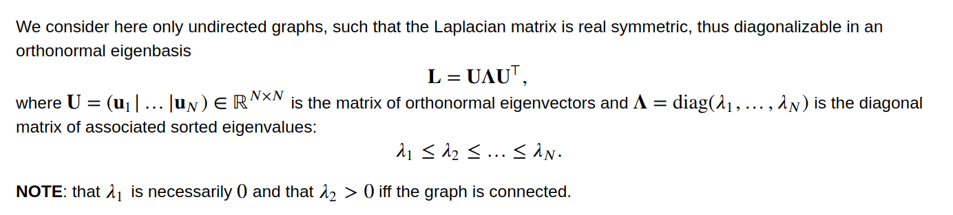
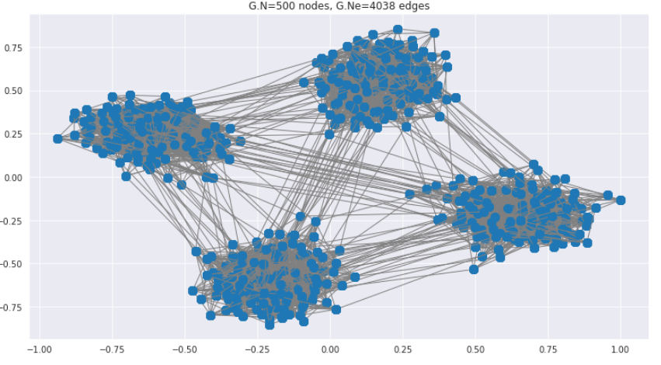
EIGEN DECOMPOSITION
Graph Convolution Network (GCN)
Source: Stanford Spectral Graph Theory
GCN Architecture
Notes:
The fundamental movement of an object/graph is determined by its eigenvectors

Slide 45
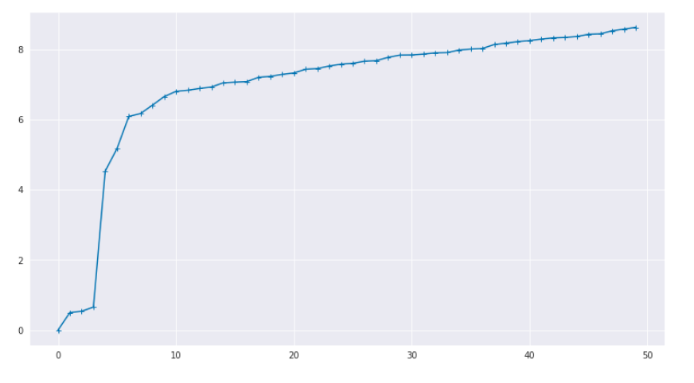
FOURIER (SPECTRAL) DOMAIN
Eigenvalues – lambda 0 to n
Graph Convolution Network (GCN)
Source: Stanford Spectral Graph Theory
GCN Architecture
Notes:
The fundamental movement of an object/graph is determined by its eigenvectors
Add labels to diagram

Slide 46
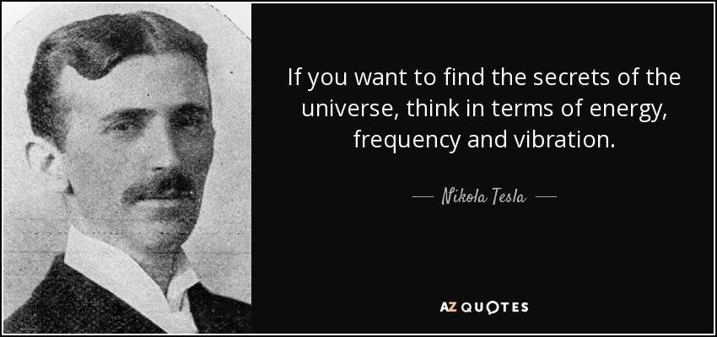
FOURIER BASIS OF A GRAPH
Graph Convolution Network (GCN)
Source: Stanford Spectral Graph Theory
GCN Architecture
Notes:
The fundamental movement of an object/graph is determined by its eigenvectors
Add labels for this

Slide 47
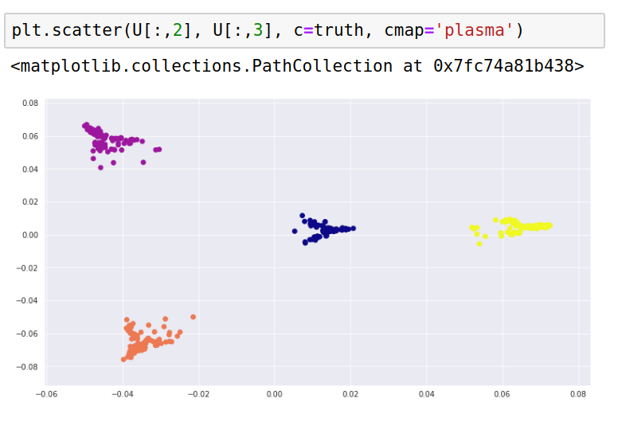
FOURIER (SPECTRAL) DOMAIN
Graph Convolution Network (GCN)
Source: Stanford Spectral Graph Theory
GCN Architecture
Notes:
The fundamental movement of an object/graph is determined by its eigenvectors
Add labels for this

Slide 48
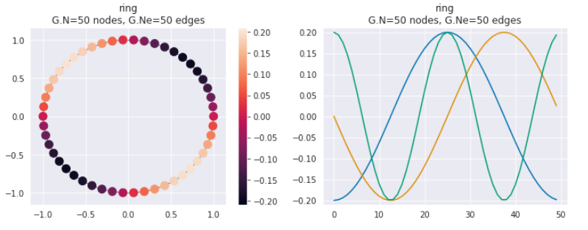
FOURIER BASIS OF A GRAPH
The first 4 eigenvectors
Graph Convolution Network (GCN)
Source: Stanford Spectral Graph Theory
GCN Architecture
Notes:
The fundamental movement of an object/graph is determined by its eigenvectors

Slide 49
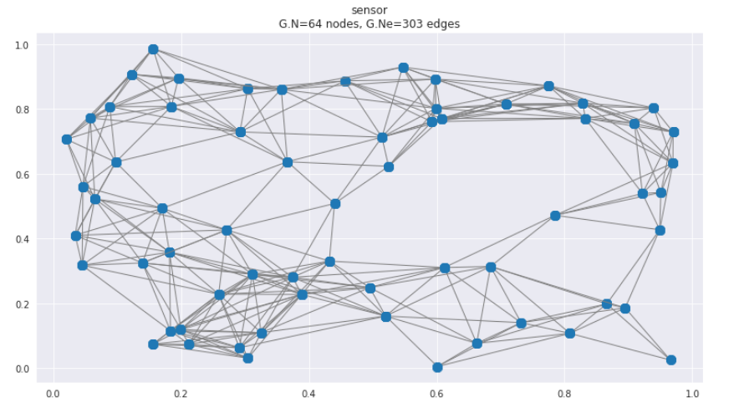
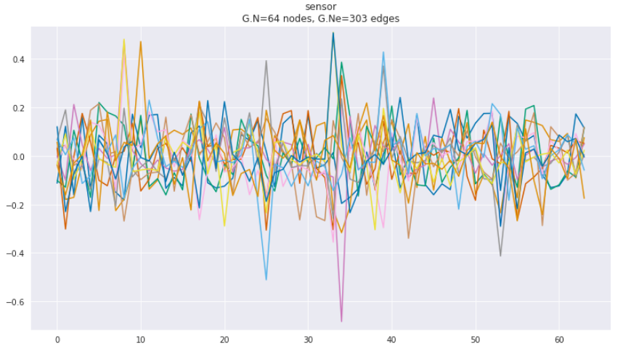
FOURIER BASIS OF A GRAPH
The first 13 eigenvectors
Graph Convolution Network (GCN)
Source: Stanford Spectral Graph Theory
GCN Architecture
Notes:
The fundamental movement of an object/graph is determined by its eigenvectors

Slide 50
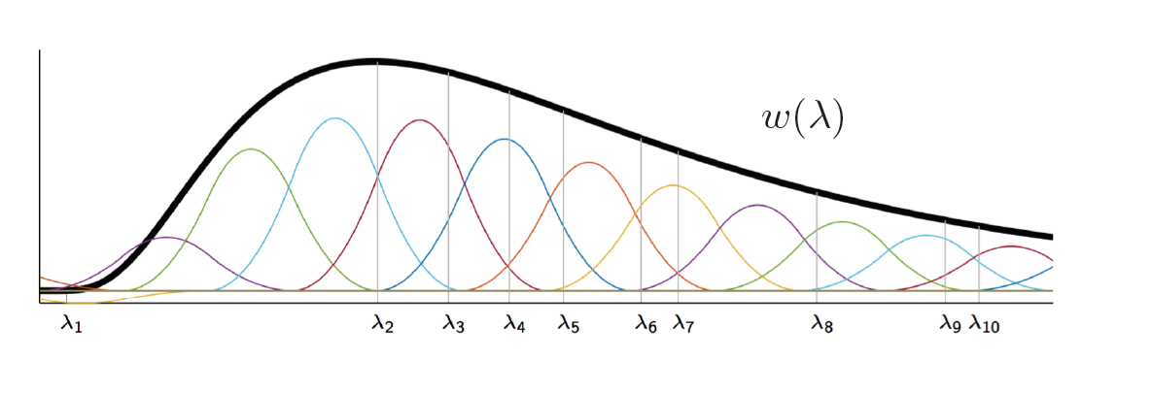
FOURIER BASIS OF A GRAPH
Graph Convolution Network (GCN)
Source: Stanford Spectral Graph Theory
GCN Architecture
Notes:
Understanding of the distribution of the signal across the geographical space of the graph
Filter heavily depends on the the basis: the eigenvectors
The smoothness of the graph signal suggests similar nodes are likely to shares connections with each other

Slide 51
Graph Convolution Network (GCN)

Slide 52
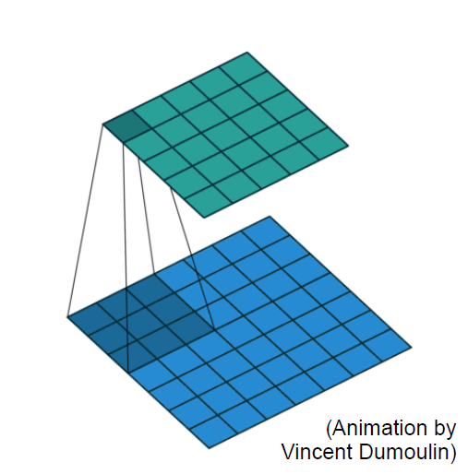
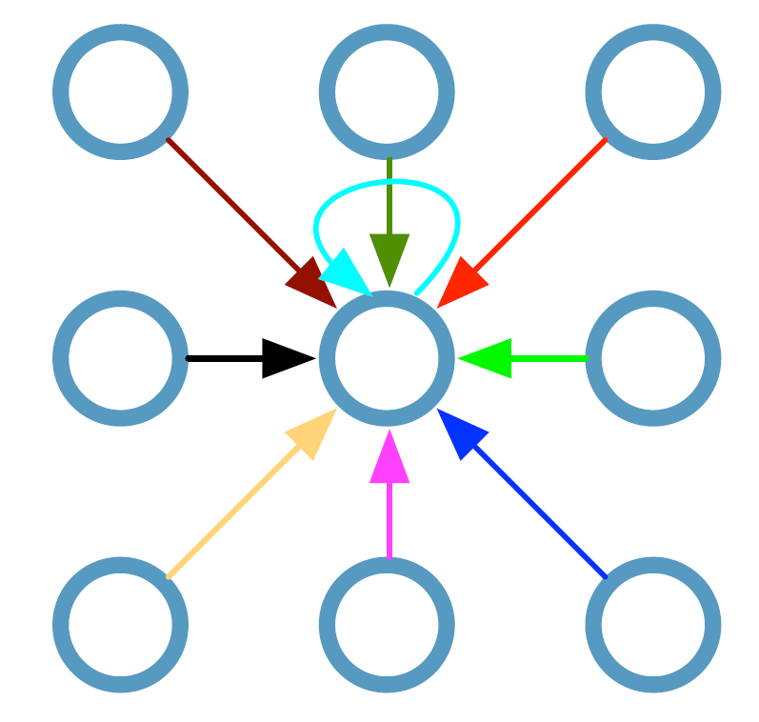
RECALL – ON GRID
W₁
W₂
W₃
W₂
W₄
W₇
W₅
W₅
Graph Convolution Network (GCN)
Source: Thomas Kipf - University of Amsterdam
GCN Architecture
Notes:
Matrices plays a significant role in describing a graph connectivity, its centrality within a network

Slide 53
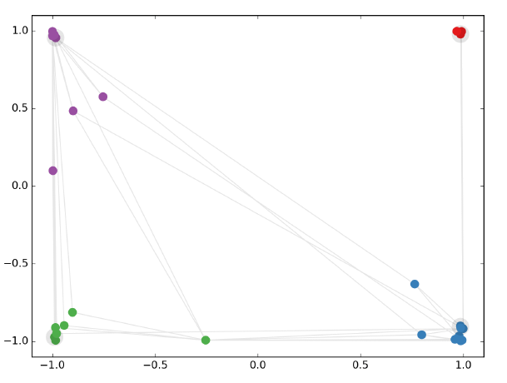
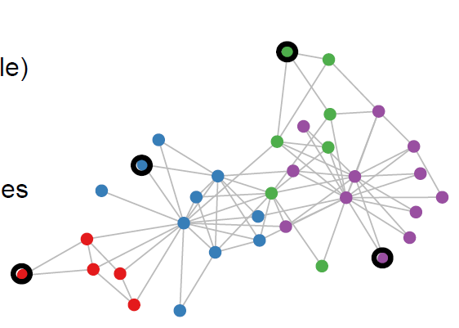
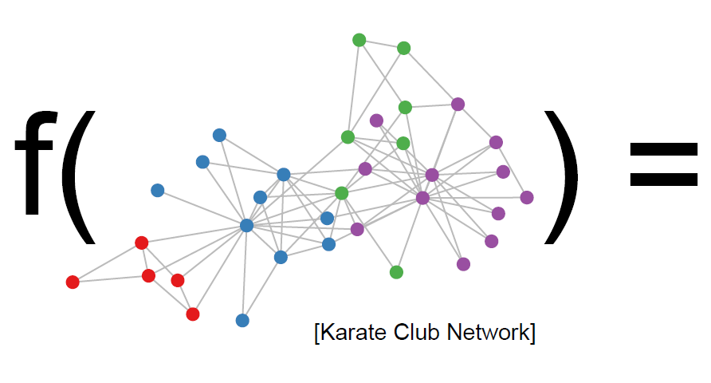
SEMI-SUPERVISED LEARNING WITH GCN
On random graph
Graph Convolution Network (GCN)
Source: Thomas Kipf - University of Amsterdam
GCN Architecture
Notes:
Matrices plays a significant role in describing a graph connectivity, its centrality within a network

Slide 54
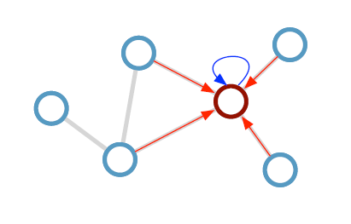
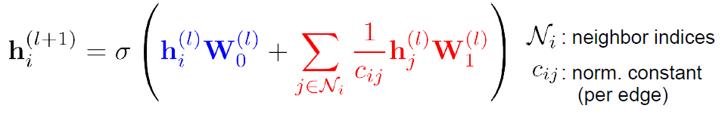
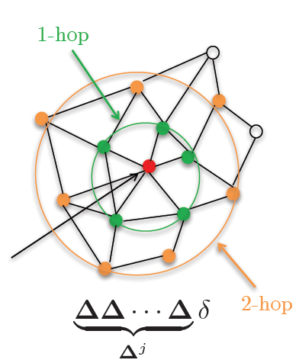
CONVOLUTION IN SPECTRAL DOMAIN
W₀
Update Rule: Localized 1st Order Chebyshev Approximation of Spectral Filter
W₁
Graph Convolution Network (GCN)
Source: Thomas Kipf - University of Amsterdam
GCN Architecture
Notes:
Graph Fourier Transform using the normalized Laplacian representation

Slide 55
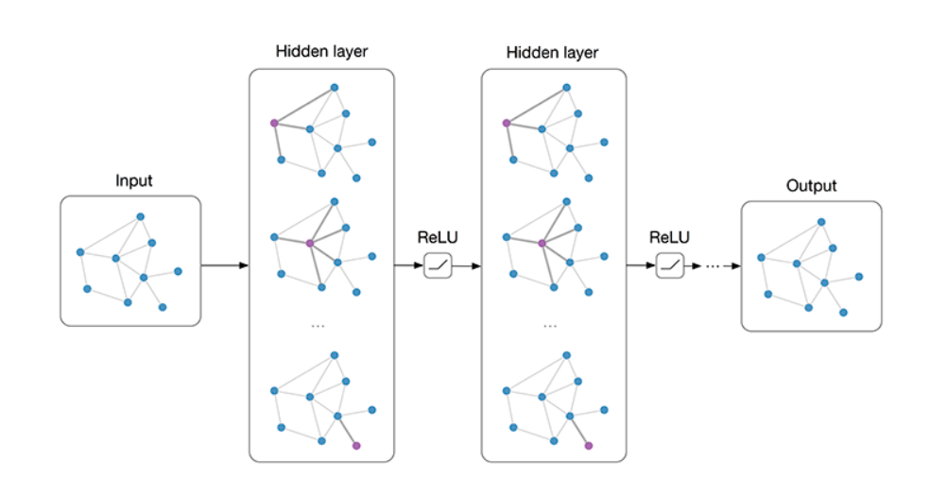
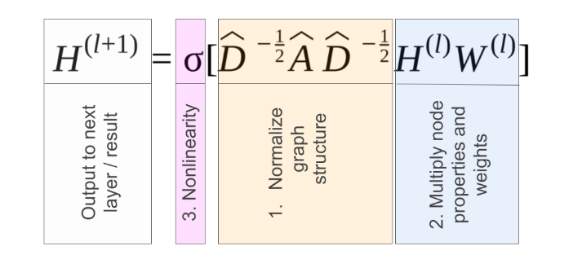
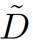
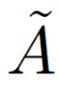
CONVOLUTION IN SPECTRAL DOMAIN
Vectorization Form:
Renormalize Trick: (Kipf, 2018)
L_{n} = D^{-1/2} L D^{-1/2} = I_{n} + D^{-1/2}A D^{-1/2}
L_{n} = ^{-1/2}
^{-1/2}
Graph Convolution Network (GCN)
Source: Thomas Kipf - University of Amsterdam
GCN Architecture
Notes:
Two-step pipeline:
1) Get embedding for every node
2) Train classifier on node embedding
Idea: Train graph-based classifier end-to-end using GCN
Evaluate loss on labeled nodes only:
set of labeled node indices
label matrix
GCN output (after softmax)

Slide 56
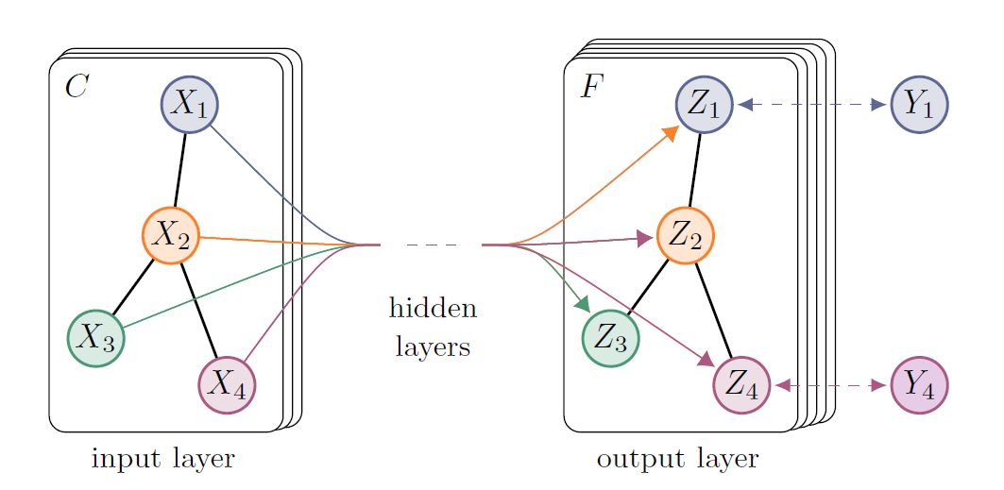
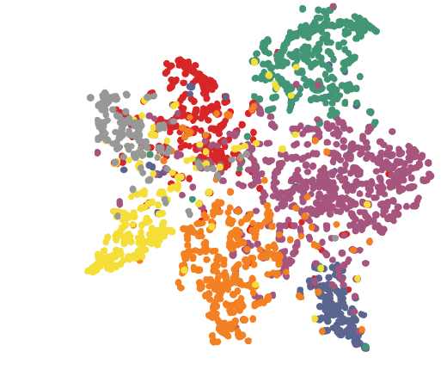
CONVOLUTION IN SPECTRAL DOMAIN
Example of a latent (embedded) representation coming out of a hidden layer:
Graph Convolution Network (GCN)
Source: Thomas Kipf - University of Amsterdam
GCN Architecture
Notes:
Graph Fourier Transform using the normalized Laplacian representation

Slide 57
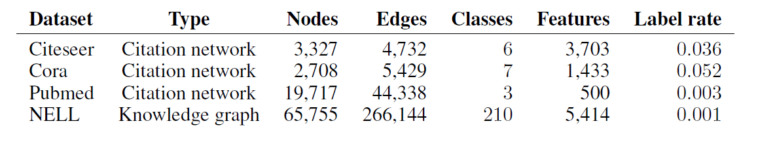
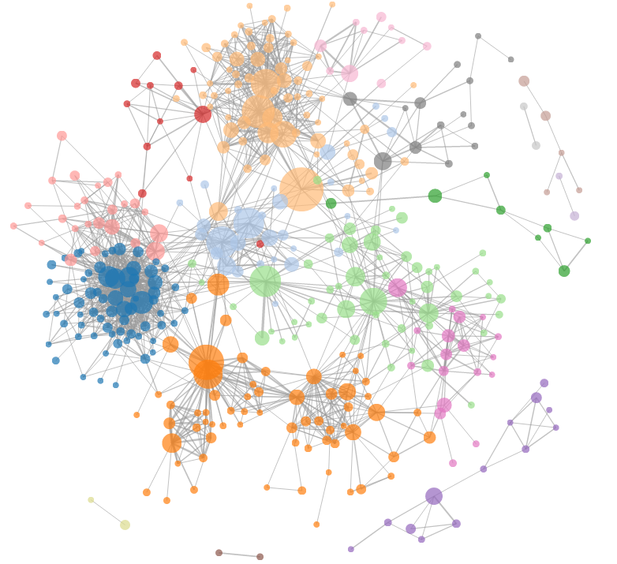
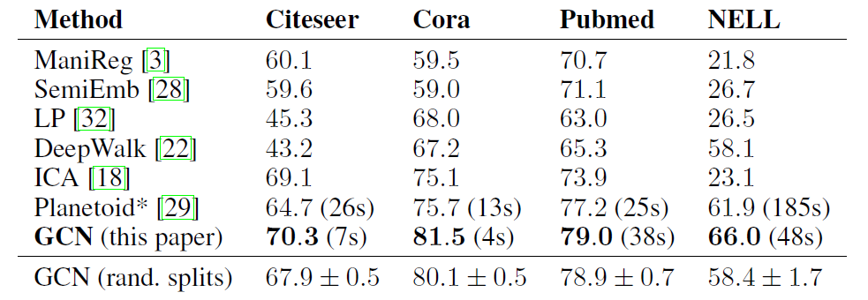
PERFORMANCE ON CITATION NETWORK
Graph Convolution Network (GCN)
Source: Thomas Kifp – Switzerland
GCN Architecture
Notes:
At this level of coarsening, take the one point.
Try to find the neighbor that is going to locally maximize normalized association
Then we create a super vertex that goes to the next coarsening level G(l+1). We do this for all points ---> result in the creation of a new graph (new adj matrix)

Slide 58
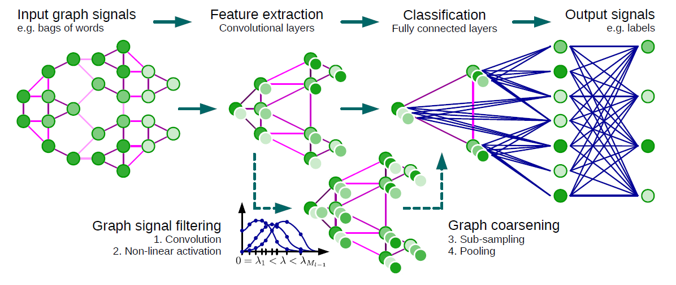
GCN ARCHITECTURE
Graph Convolution Network (GCN)
Source: Nanyang Technological University - Singapore
GCN Architecture
Notes:
Matrices plays a significant role in describing a graph connectivity, its centrality within a network

Slide 59
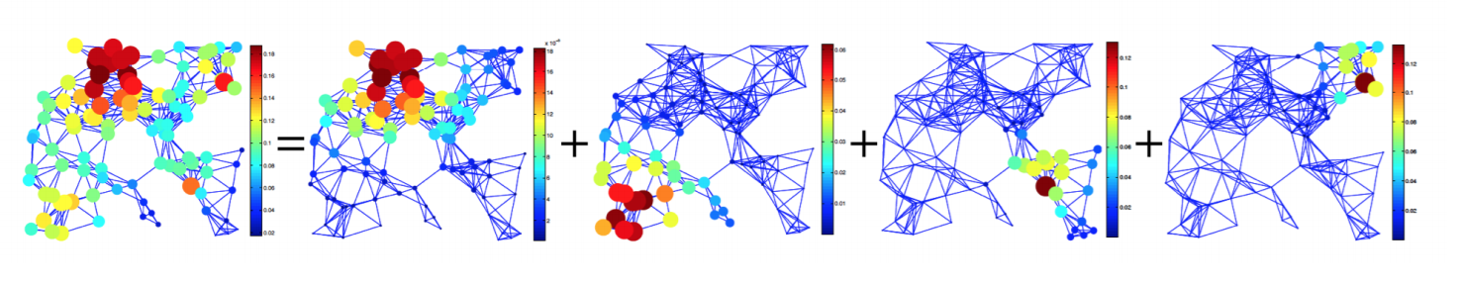
HEAT DIFUSION OF GRAPH
Graph Convolution Network (GCN)
Source: Nanyang Technological University - Singapore
GCN Architecture
Notes:
Matrices plays a significant role in describing a graph connectivity, its centrality within a network

Slide 60

CONVOLUTION IN SPECTRAL DOMAIN
Chebyshev Approximation to Kth order where K << N
Graph Convolution Network (GCN)
Source: Nanyang Technological University - Singapore
GCN Architecture
Notes:
Understanding of the distribution of the signal across the geographical space of the graph

Slide 61


GRAPH COARSENING – MAX POOLING
Graph Convolution Network (GCN)
Source: Nanyang Technological University - Singapore
GCN Architecture
Notes:
At this level of coarsening, take the one point.
Try to find the neighbor that is going to locally maximize normalized association
Then we create a super vertex that goes to the next coarsening level G(l+1). We do this for all points ---> result in the creation of a new graph (new adj matrix)

Slide 62


GRAPH COARSENING – MAX POOLING
Graph Convolution Network (GCN)
Source: Nanyang Technological University - Singapore
GCN Architecture
Notes:
At this level of coarsening, take the one point.
Try to find the neighbor that is going to locally maximize normalized association
Then we create a super vertex that goes to the next coarsening level G(l+1). We do this for all points ---> result in the creation of a new graph (new adj matrix)

Slide 63

GRAPH COARSENING – MAX POOLING
NP-Hard
Graph Convolution Network (GCN)
Source: Nanyang Technological University - Singapore
GCN Architecture
Notes:
Decompose G into smaller meaningful clusters… In a way we do multi-level clustering

Slide 64
CONVOLUTION IN SPECTRAL DOMAIN
Graph Convolution Network (GCN)
Source: Nanyang Technological University - Singapore
GCN Architecture
Notes:
Graph Fourier Transform using the normalized Laplacian representation

